Slide 1

COIS 3320: Fundamentals of Operating Systems
Alaadin Addas
Week 12
The End *Dramatic Music*

Slide 2
Overview
Final Exam:
General Information
Delivery Details
MS Teams *Important*
Content Covered
Office Hours
Content Review
Exercise 1 – Page Reference Strings
Exercise 2 – Paging & Segmentation
Exercise 3 – Banker’s Algorithm
Lab 5

Slide 3
Final Exam – General Information
Your final exam is scheduled on the 16th of April at 3PM, exactly 1 week from today!
The final exam duration is two hours and forty minutes, in addition to twenty minutes for testing and finalizing your submission (3 hours total).
The final exam can be split up into two parts.
Part 1 will contain the theory (short answer) questions, and the questions that require some calculation (like your assignment questions).
This portion will account for 80% of the final.
Part 2 will contain C programming questions.
This portion will account for 20% of the final.
Both parts are released simultaneously (its all one document).

Slide 4
Final Exam Delivery Details
The final exam will be delivered via Blackboard.
15 minutes before the final exam begins, I usually start a General Meeting on MS Teams to go through the instructions.
The instructions will also be written on the exam itself. Ignore them at your own risk!
Your final exam answers must be typed, I do not accept handwritten answers.
The final exam is also completely open book/open internet.
Communication with a third party is strictly forbidden.
Warning: Unlike the midterm, there are no second chances on a final. Especially if you already received a warning on the midterm!
If you use a source to answer a general theory question, the answer must be in your own words, and you must cite your source. Just provide the link, no need for a specific citation format.

Slide 5
MS Teams
I keep the MS Teams meeting that we started before the exam open so that you can ask questions quickly.
If you have a question that needs to be answered in private, we will typically switch to a private chat/call and discuss it there.
Please don’t email me during the final!!!
Communication via MS Teams is crucial.

Slide 6
Final Exam Content
What is fair game on the final exam?
Lecture content.
Content from the textbook (chapters 1-9).
C programming (taught during the lectures and via the labs).
Concepts and questions covered in the assignments.
While the final exam is cumulative, we already covered chapters 1-5 on the midterm. Expect the final to be weighted more heavily towards chapters 6-9.

Slide 7
Office Hours
The dedicated office hours for the final exam are going to be held on Wednesday from 2PM – 4PM.
I will also make myself available about an hour before the exam as well to answer any questions that you may have.
I know the ideal time for the office hours would have been Thursday for many.
Unfortunatley, I could not host office hours on Thursday because I have another final, I need to take care of that day.

Slide 8
Questions?

Slide 9
Onto Content Review

Slide 10
Paging & Segmentation
Before we begin the exercises, can anyone explain paging and segmentation to me at a very high level?
What is the difference between a page frame and a page?
Hint: Virtual Memory V.S. Physical Memory

Slide 11
Exercise 1 – Page Reference Strings
Consider the following page reference string: 1 2 1 3 4 0 2 3 0 1 3 4 2 0 4 2 1 0.
How many page faults would occur for the Optimal, FIFO, and LRU algorithms in a three-frame system (all frames are initially empty). Make sure you show your work.

Slide 12
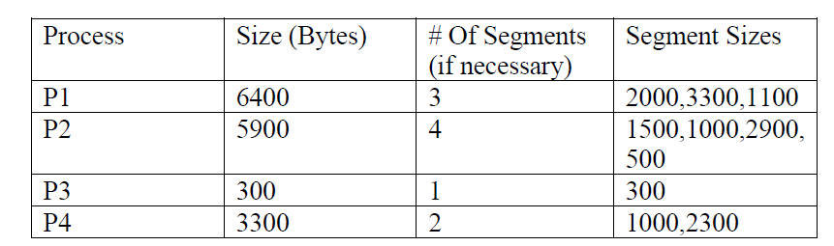
Exercise 2 – Paging & Segmentation
Consider the following list of processes and their associated sizes.
Assuming that Paging is used, show the page table for each process under the following scenario: assume a page size of 1000 bytes and a main memory of size 32 frames with Frames 0, 1, 3, 5,8, 9, 15, 16, 17, 21, 24 and 31 currently utilized. Also assume the free frames are ordered by number in the free-space list. Each Page Table entry should contain Page# and Frame#.

Slide 13
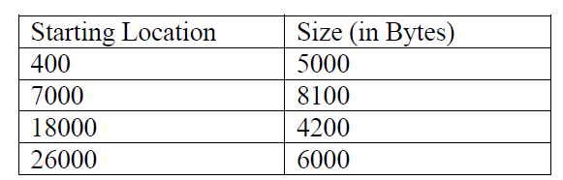
Exercise 2 – Paging & Segmentation
Assuming that Segmentation is used, show the Segment Table for each process (if first-fit allocation is used) under the following scenario:
Given a main memory size of 32,000 bytes with the following areas currently available. Assume a segment is added at the beginning of the free hole (a segment of 2000 bytes would start at address 400 instead of finishing at 5000):

Slide 14
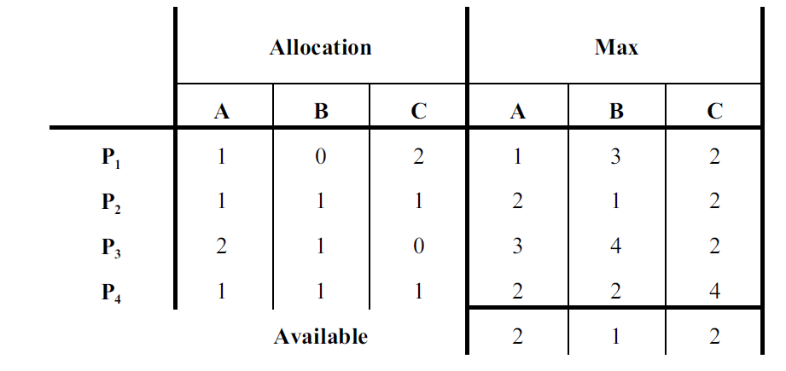
Exercise 3 – Banker’s Algorithm
Given the following snapshot of a system:
Is the system in a safe state? If yes, provide a safe sequence. Show your work.
Can a request P4(2,3,4) be granted? Show your work.

Slide 15
Lab 5
Deadline: April 9th by 2:00PM
Submission: Zip file containing commented .C File, PDF containing the testing screenshots. For each test case make sure you include:
A brief description the test.
The input.
The expected output.
The actual output (screenshot).
A quick comment regarding whether the expected output matched the actual output.

Slide 16
Lab 5
Description: Write a C program that will output the sum, and the product of integer command line arguments.
For example:
./lab5 1 2 3 4
Sum: 10
Product: 24

